Slide 1
DynamoDb
Anju munoth

Slide 2
Unpredicatability of RDBMS
Performance is like a black box.
Subject to a number of factors — table size, index size, concurrent queries — that are difficult to test accurately ahead of time.
Poor time complexity characteristics of SQL joins
Difficulty in horizontally scaling
Unbounded nature of queries
No inherent limit to the amount of data you can scan in a single request to the database

Slide 3
Amazon DynamoDB
Fast, flexible NoSQL database service for single-digit millisecond performance at any scale

Slide 4
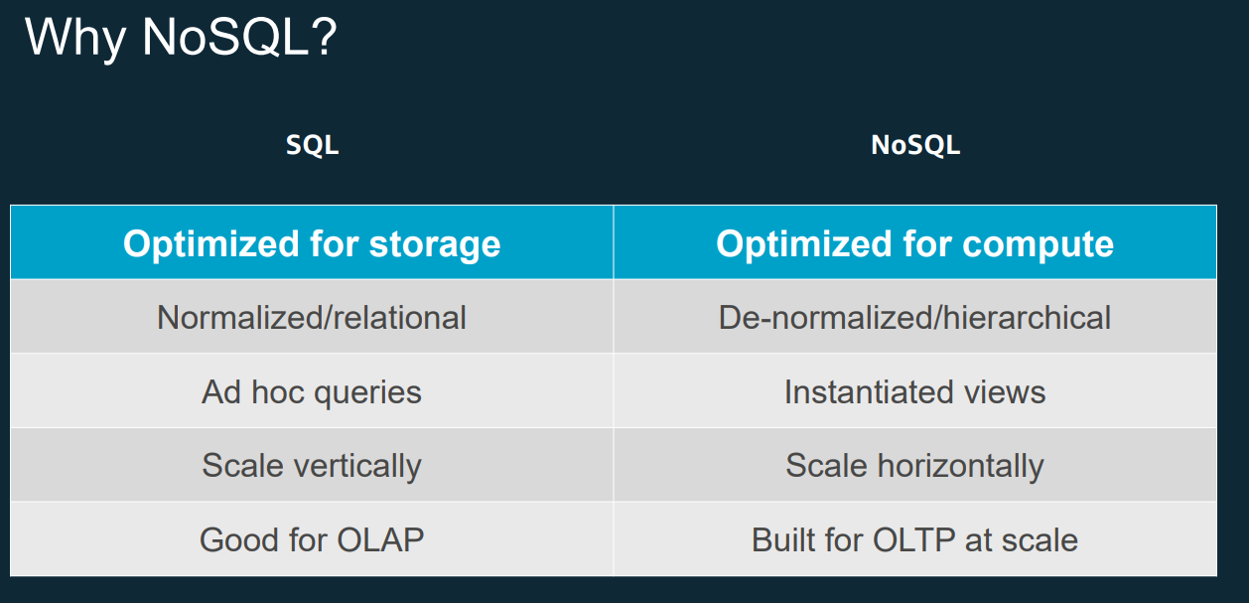

Slide 5
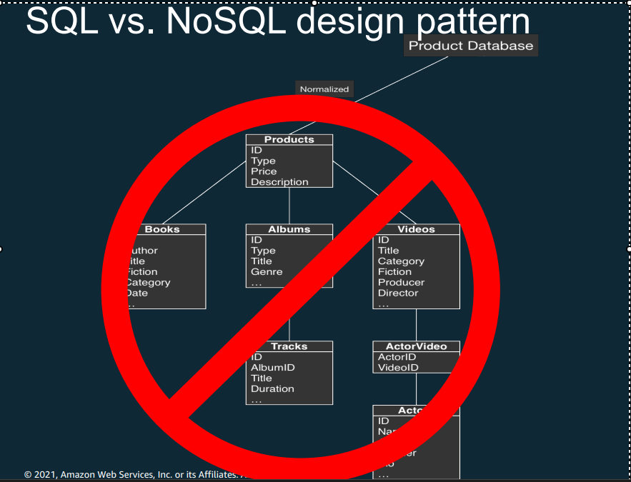

Slide 6
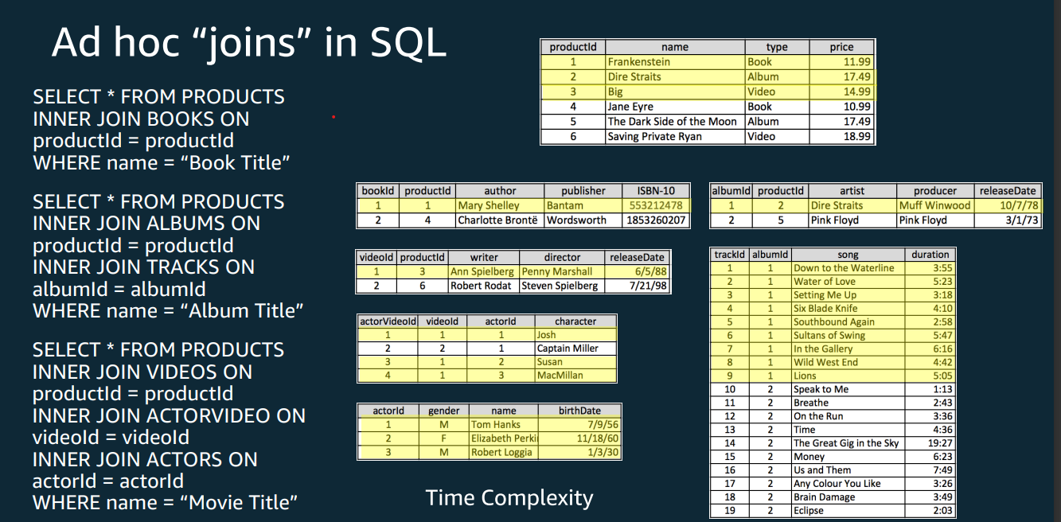

Slide 7
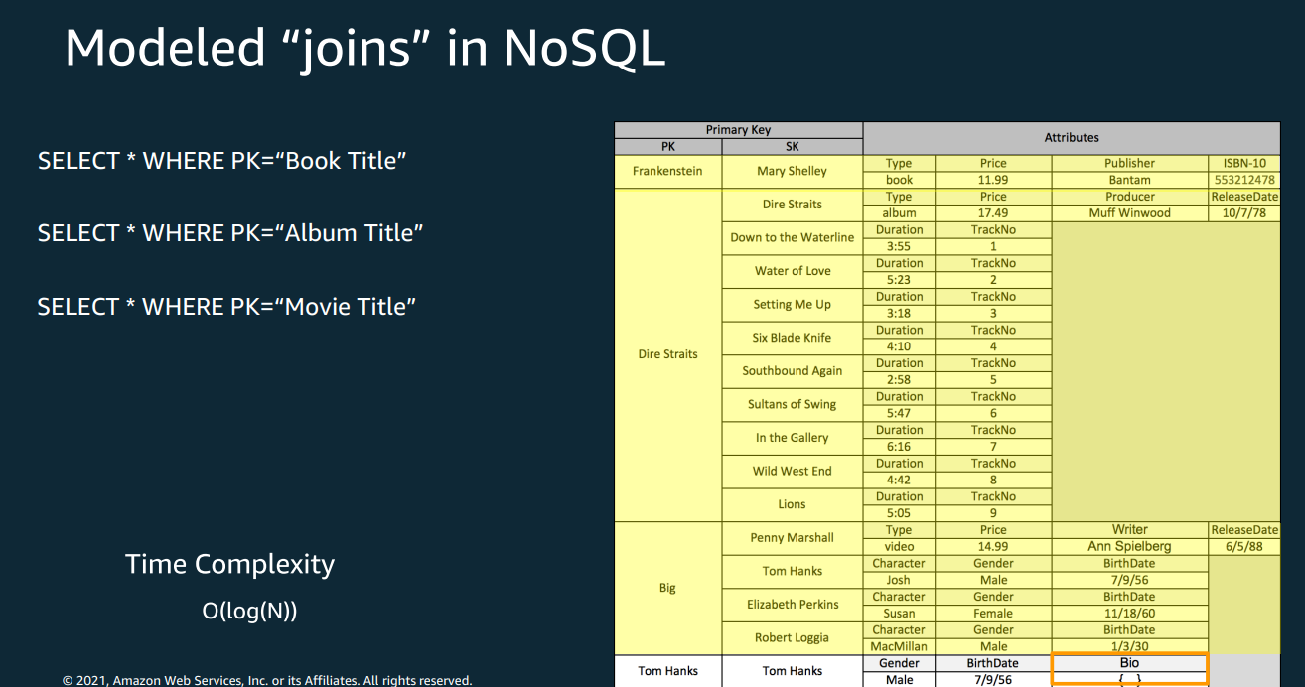

Slide 8
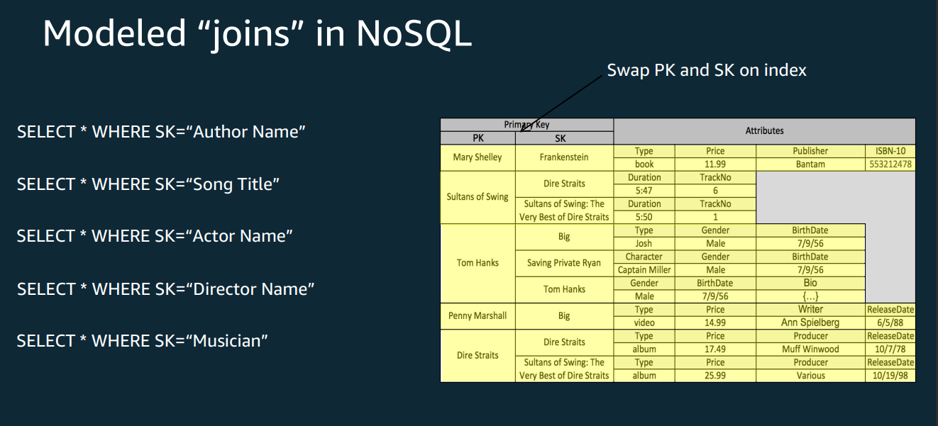

Slide 9
Dynamodb
Amazon DynamoDB is a fully managed, serverless, key-value NoSQL database designed to run high-performance applications at any scale.
DynamoDB offers built-in security, continuous backups, automated multi-Region replication, in-memory caching, and data import and export tools.

Slide 10
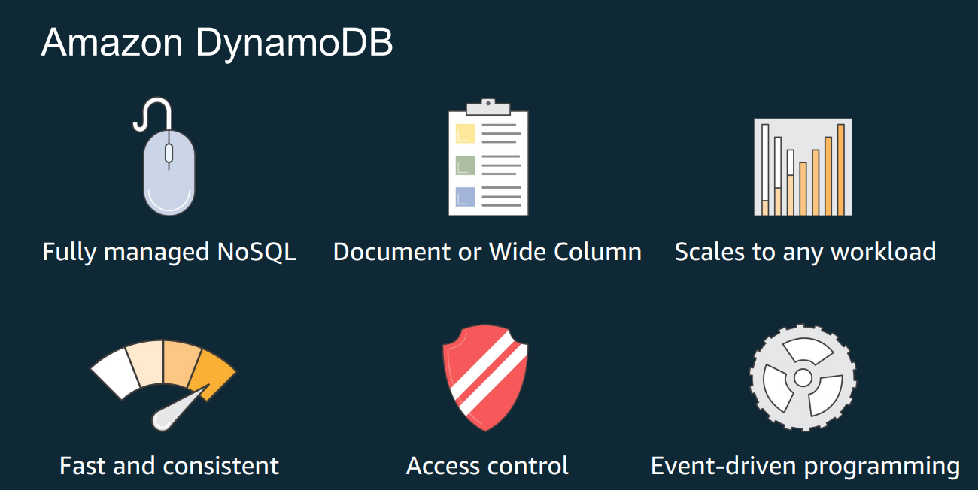

Slide 11
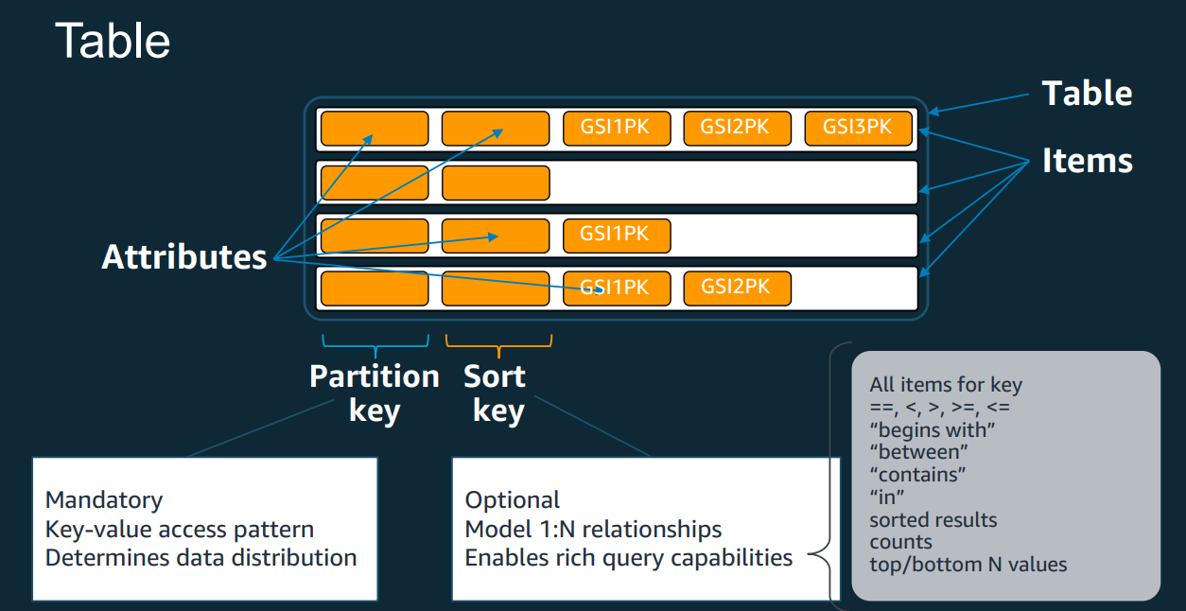

Slide 12
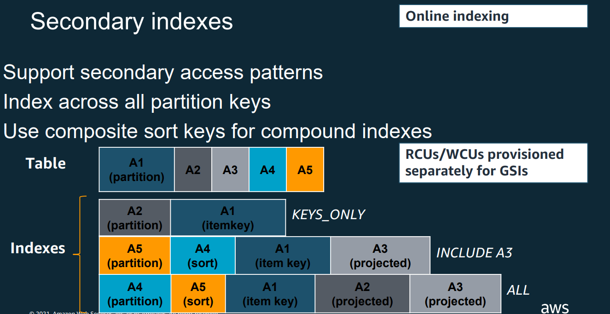

Slide 13
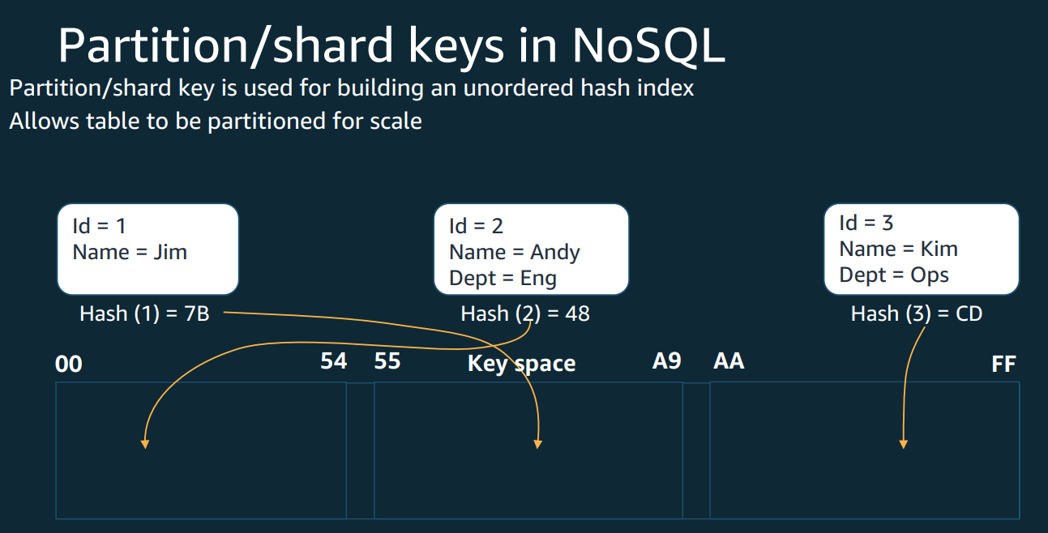

Slide 14
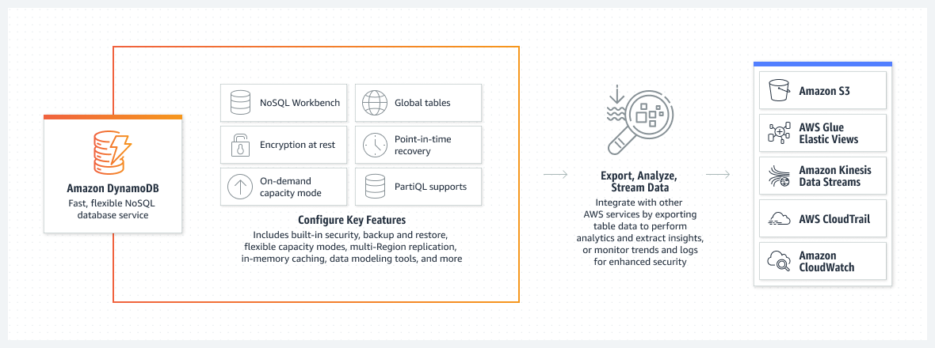
How it works

Slide 15
Important features of dynamodb
Deliver apps with consistent single-digit millisecond performance, nearly unlimited throughput and storage, and automatic multi-Region replication.
Secure your data with encryption at rest, automatic backup and restore, and guaranteed reliability with an SLA of up to 99.999% availability.
Focus on innovation and optimize costs with a fully managed serverless database that automatically scales up and down to fit your needs.
Integrate with AWS services to do more with your data. Use built-in tools to perform analytics, extract insights, and monitor traffic trends.

Slide 16
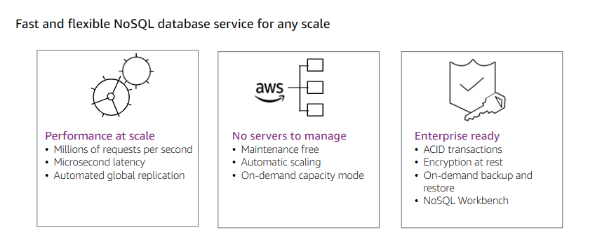

Slide 17
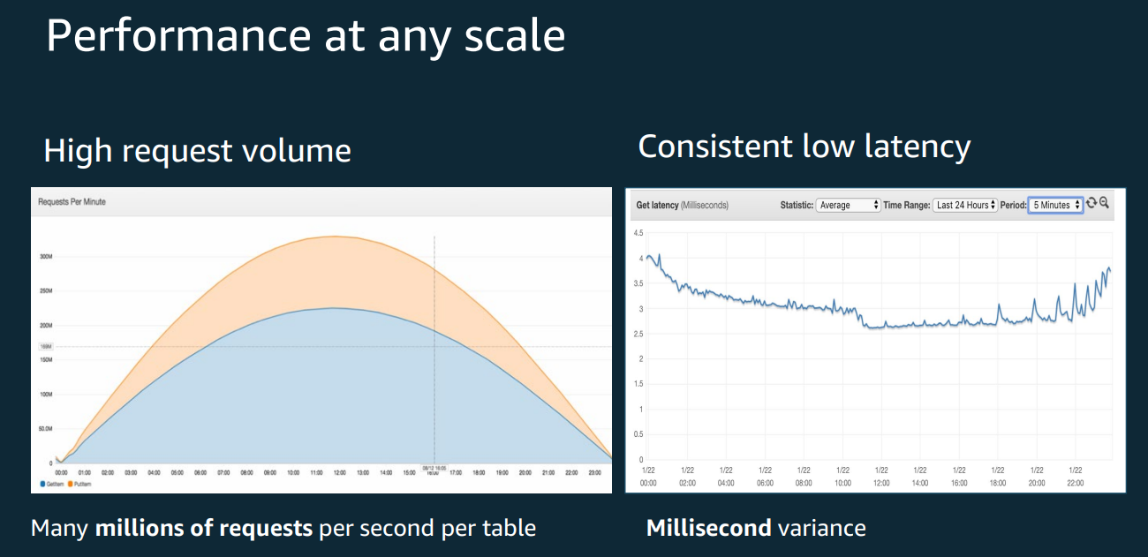

Slide 18
Performance at scale
DynamoDB is a key-value and document database that supports tables of virtually any size with horizontal scaling.
Scales to more than 10 trillion requests per day and with tables that have more than ten million read and write requests per second and petabytes of data storage.

Slide 19
Key-value and document data models
DynamoDB supports both key-value and document data models.
Flexible schema, so each row can have any number of columns at any point in time.
Easily adapt the tables as your business requirements change, without having to redefine the table schema as in relational databases.

Slide 20
DynamoDB Accelerator
Provide Microsecond latency
DynamoDB Accelerator (DAX) is an in-memory cache that delivers fast read performance for your tables at scale by enabling you to use a fully managed in-memory cache.
Can improve the read performance of your DynamoDB tables by up to 10 times—taking the time required for reads from milliseconds to microseconds, even at millions of requests per second.

Slide 21
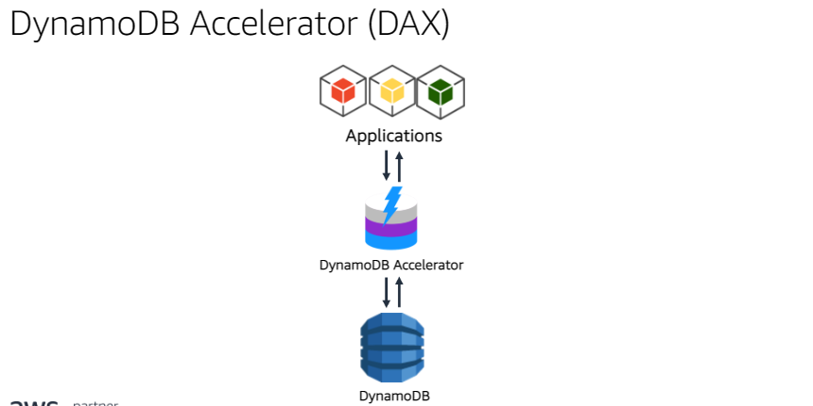

Slide 22
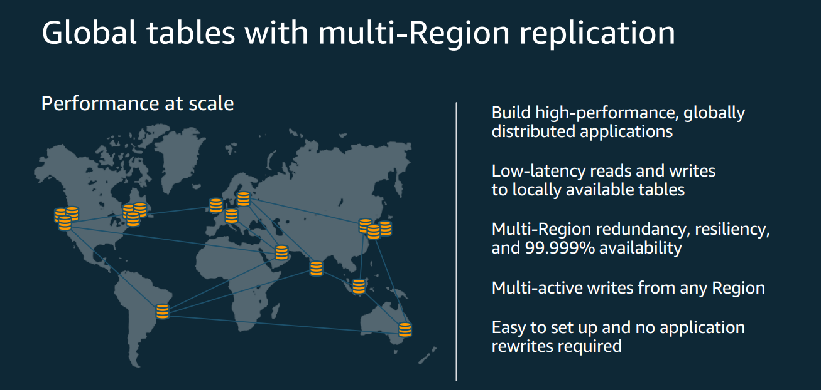

Slide 23
Automated global replication with global tables
DynamoDB global tables replicate your data automatically across your choice of AWS Regions and automatically scale capacity to accommodate your workloads.
With global tables, your globally distributed applications can access data locally in the selected Regions to get single-digit millisecond read and write performance.

Slide 24
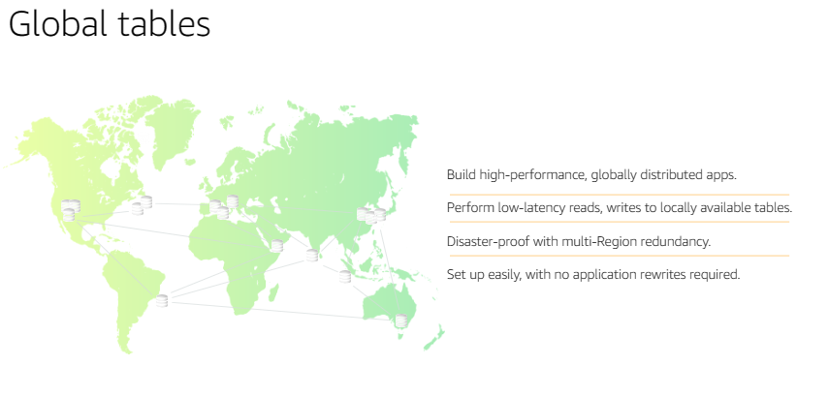

Slide 25
Streaming
Advanced streaming applications with Kinesis Data Streams for DynamoDB
Amazon Kinesis Data Streams for DynamoDB captures item-level changes in your DynamoDB tables as a Kinesis data stream.
Build advanced streaming applications such as real-time log aggregation, real-time business analytics, and IoT data capture.
Through Kinesis Data Streams, also can use Amazon Kinesis Data Firehose to deliver DynamoDB data automatically to other AWS services.

Slide 26
Serverless
With DynamoDB, there are no servers to provision, patch, or manage, and no software to install, maintain, or operate.
DynamoDB automatically scales tables to adjust for capacity and maintains performance with zero administration.
Availability and fault tolerance are built in, eliminating the need to architect your applications for these capabilities.

Slide 27
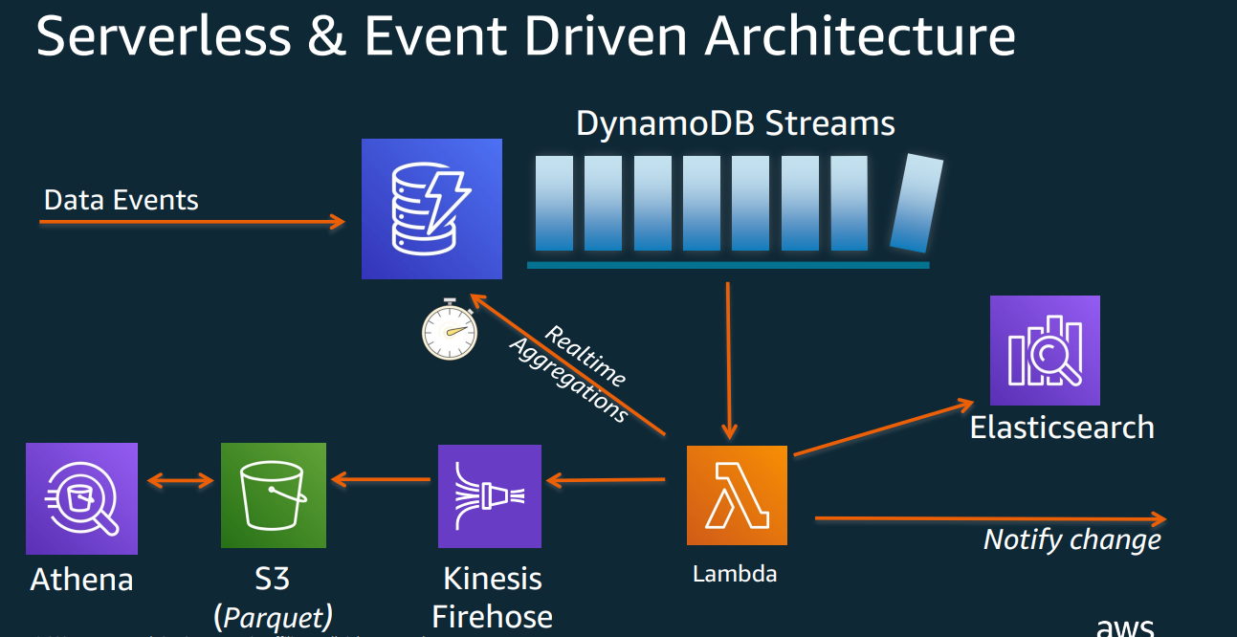

Slide 28
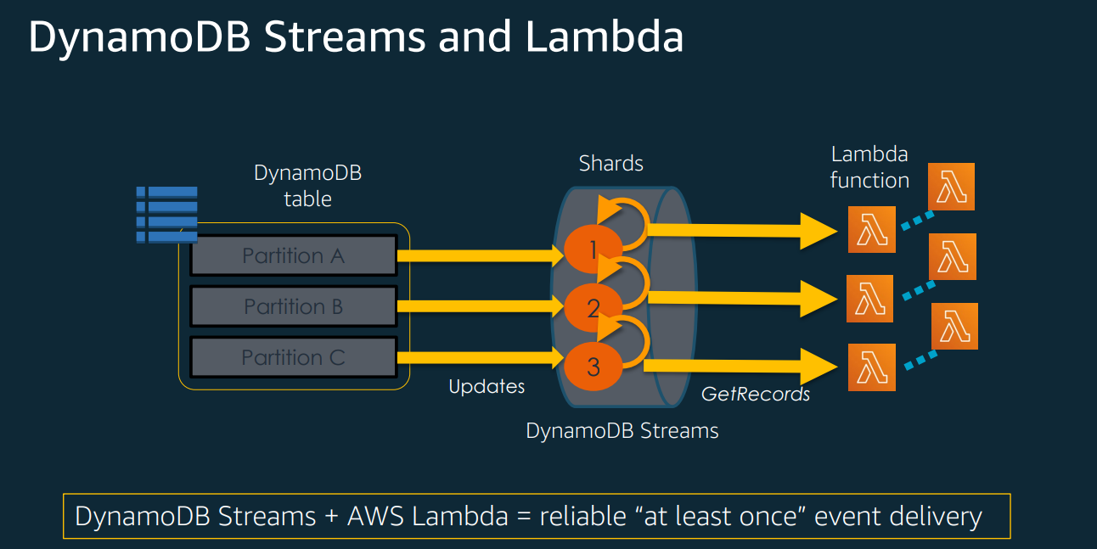

Slide 29
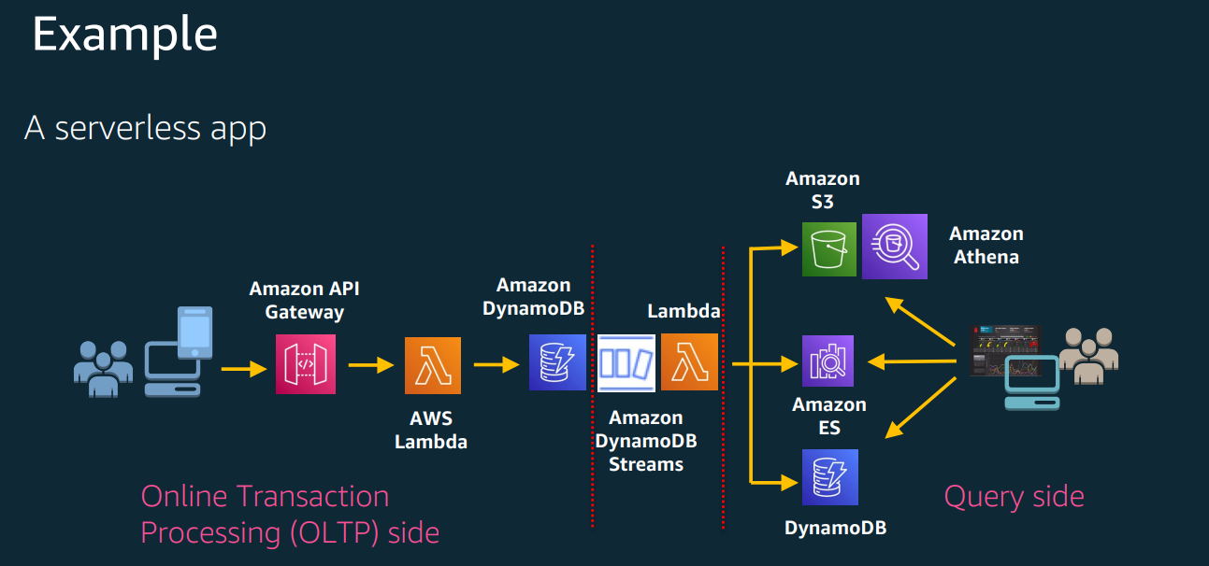

Slide 30
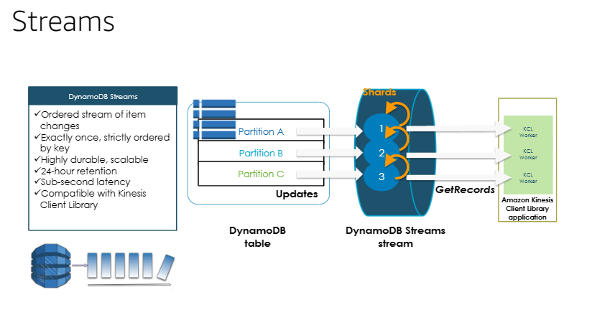

Slide 31
Read/write capacity modes
DynamoDB provides capacity modes for each table: on-demand and provisioned.
For workloads that are less predictable for which you are unsure whether you'll have high utilization, on-demand capacity mode takes care of managing capacity for you, and you pay only for what you consume.
Tables using provisioned capacity mode require you to set read and write capacity.
Provisioned capacity mode is more cost effective when you’re confident you’ll have decent utilization of the provisioned capacity you specify

Slide 32
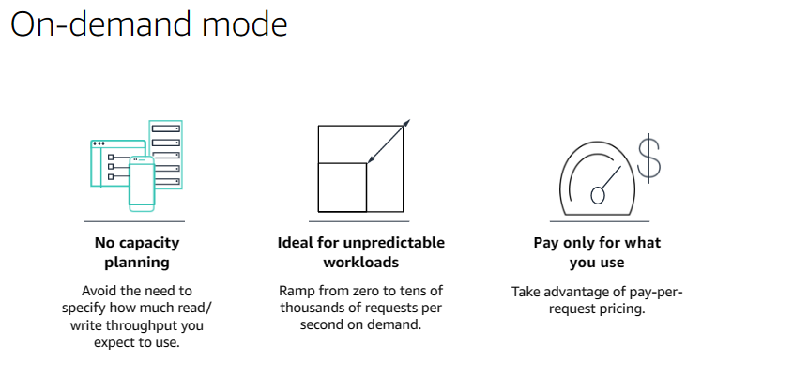

Slide 33
On-demand mode
For tables using on-demand capacity mode, DynamoDB instantly accommodates your workloads as they ramp up or down to any previously reached traffic level.
If a workload’s traffic level hits a new peak, DynamoDB adapts rapidly to accommodate the workload.
Can use on-demand capacity mode for both new and existing tables, and can continue using the existing DynamoDB APIs without changing code.

Slide 34
Auto scaling
For tables using provisioned capacity, DynamoDB delivers automatic scaling of throughput and storage based on your previously set capacity by monitoring the performance usage of your application.
If your application traffic grows, DynamoDB increases throughput to accommodate the load.
If your application traffic shrinks, DynamoDB scales down so that you pay less for unused capacity.

Slide 35
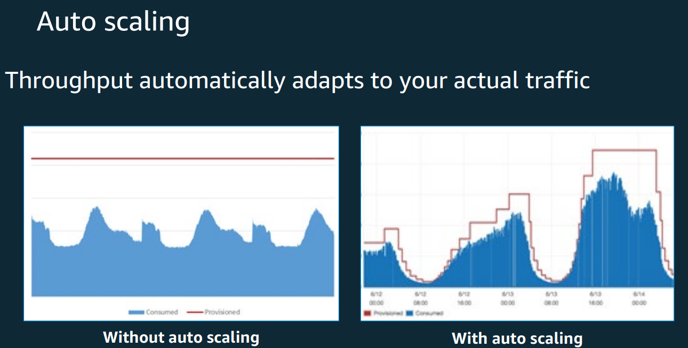

Slide 36
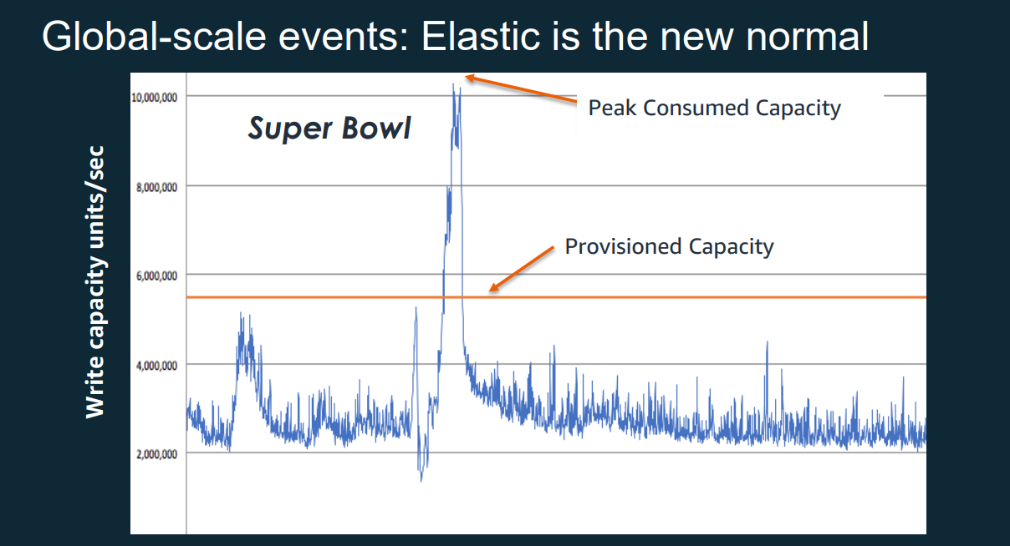

Slide 37
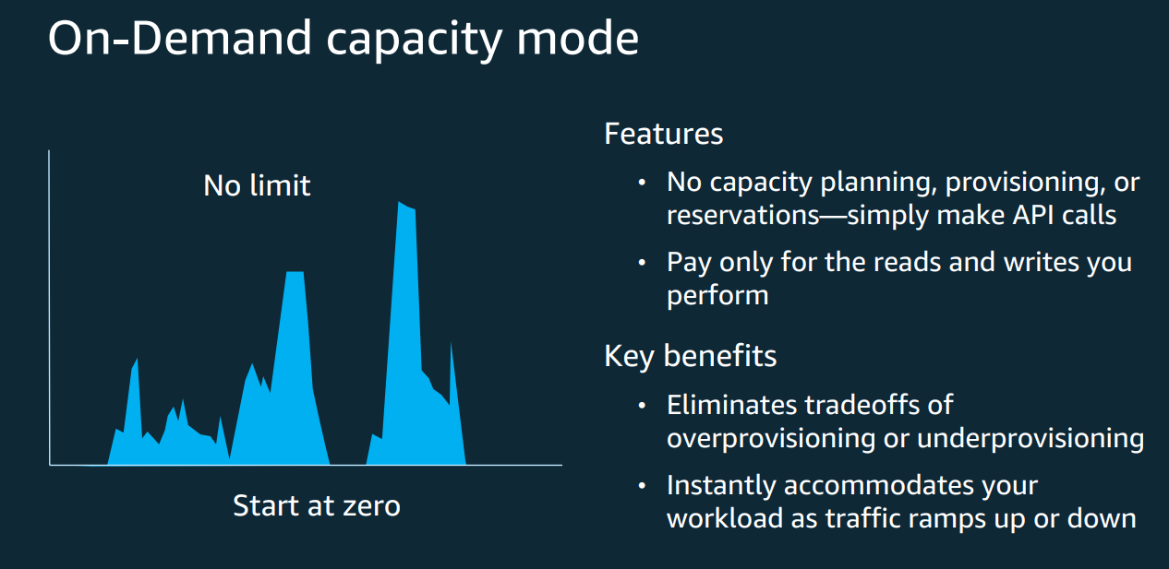

Slide 38
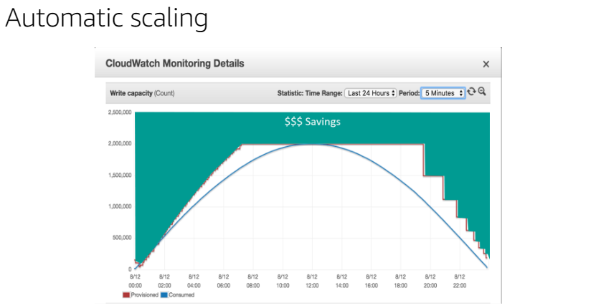

Slide 39
Change tracking with triggers
DynamoDB integrates with AWS Lambda to provide triggers.
Using triggers, can automatically run a custom function when item-level changes in a DynamoDB table are detected.
With triggers, can build applications that react to data modifications in DynamoDB tables.
Lambda function can perform any actions you specify, such as sending a notification or initiating a workflow.

Slide 40
Enterprise ready
DynamoDB is built for mission-critical workloads, including support for atomicity, consistency, isolation, and durability (ACID) transactions for a broad set of applications that require complex business logic.
DynamoDB helps secure your data with encryption and continuously backs up your data for protection, with guaranteed reliability through a service level agreement.

Slide 41
ACID transactions
DynamoDB provides native, server-side support for transactions, simplifying the developer experience of making coordinated, all-or-nothing changes to multiple items both within and across tables.
With support for transactions, developers can extend the scale, performance, and enterprise benefits of DynamoDB to a broader set of mission-critical workloads.

Slide 42
Encryption at rest
DynamoDB encrypts all customer data at rest by default.
Encryption at rest enhances the security of your data by using encryption keys stored in AWS Key Management Service (AWS KMS).
With encryption at rest, you can build security-sensitive applications that meet strict encryption compliance and regulatory requirements.
Default encryption using AWS-owned KMS keys is provided at no additional charge.

Slide 44
Point-in-time recovery
Point-in-time recovery (PITR) helps protect your DynamoDB tables from accidental write or delete operations.
PITR provides continuous backups of your DynamoDB table data, and you can restore that table to any point in time up to the second during the preceding 35 days.
Can enable PITR or initiate backup and restore operations with a single click in the AWS Management Console or a single API call.

Slide 45
On-demand backup and restore
On-demand backup and restore allows you to create full backups of your DynamoDB tables’ data for data archiving, which can help you meet your corporate and governmental regulatory requirements.
Can back up tables from a few megabytes to hundreds of terabytes of data and not affect performance or availability to your production applications.

Slide 46
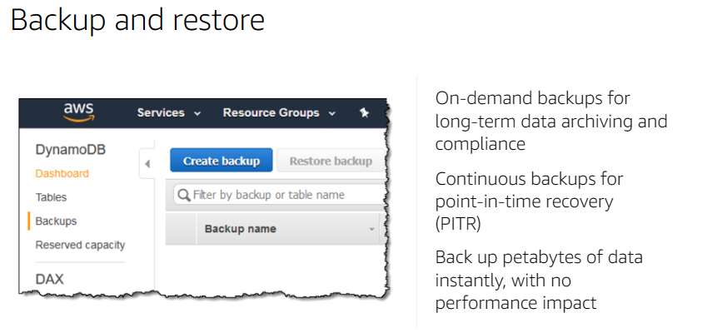

Slide 47
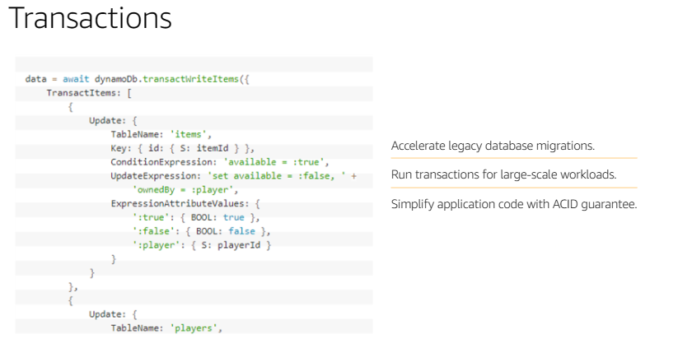

Slide 48
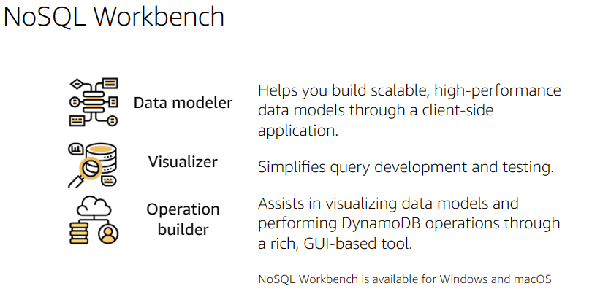

Slide 49
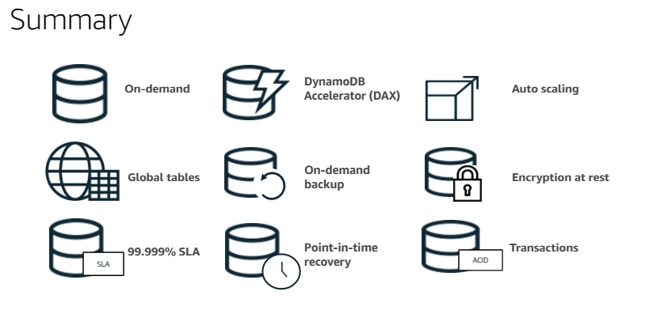

Slide 50
Dynamodb
DynamoDB does not allow joins;
Based on access patterns, can design your database to avoid joins
storage prices have dropped to the floor. Compute is the most valuable resource in your systems, so it makes sense to optimize for compute over storage
DynamoDB forces you to segment the data, allowing for easier horizontal scaling;
DynamoDB puts explicit bounds on the queries.
DynamoDB does not have support for any aggregation operations, such as max, min, avg, or sum

Slide 51
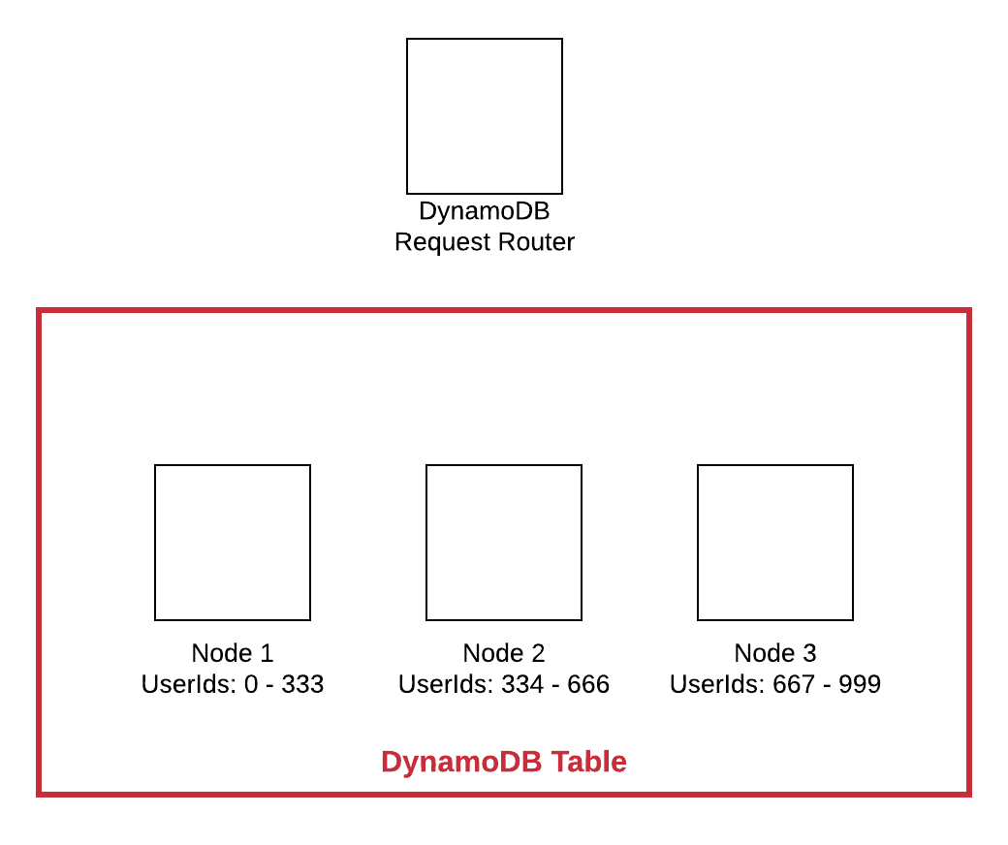
Dynamodb hashes the partition key value before assigning it to a node. This helps distribute the data better, particularly when the partition key is monotonically increasing

Slide 52
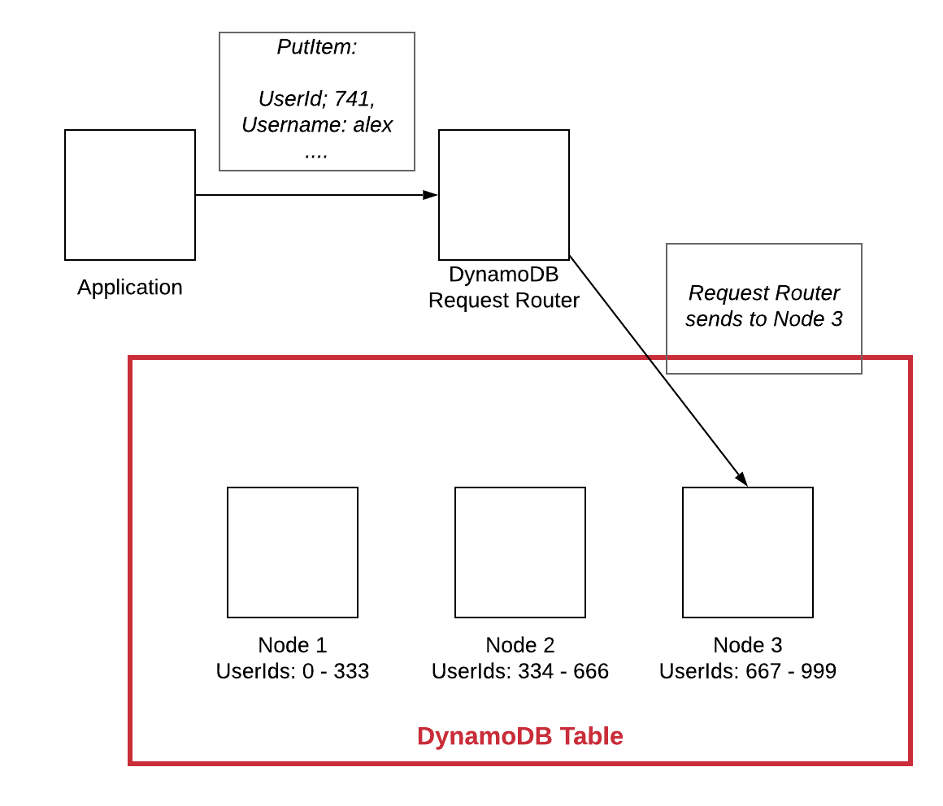

Slide 53
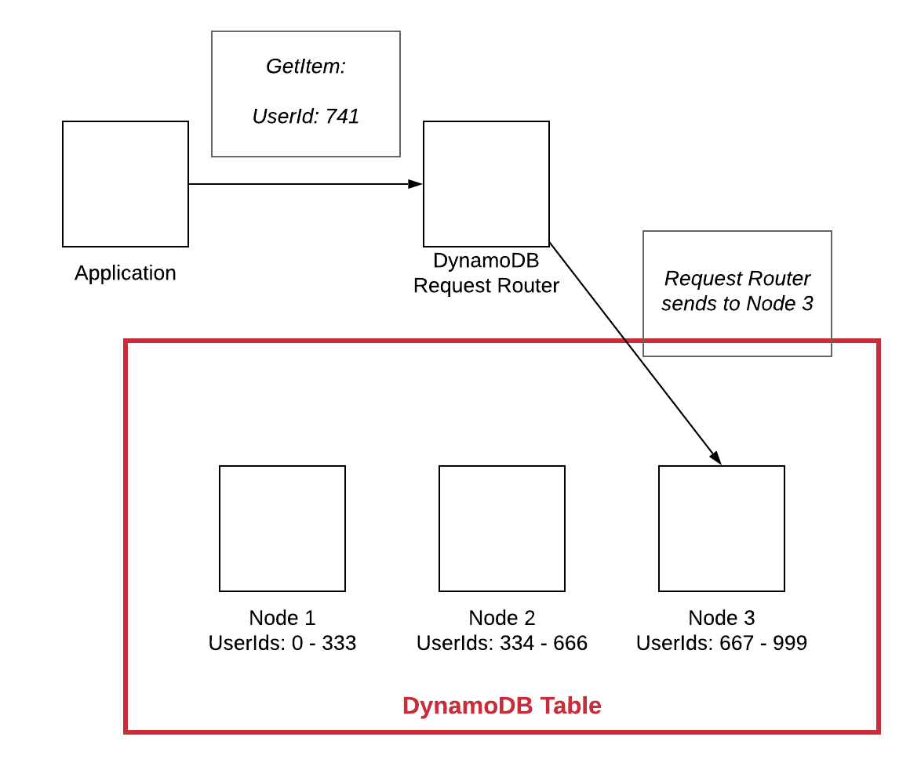
At read time, all queries must include the partition key.
Just as with the write, this operation can be sent to the node that is responsible for that chunk of the data without bothering the other nodes in the cluster.

Slide 54
Data Modelling in dynamodb
Single-table design
SQL joins are also expensive --Require scanning large portions of multiple tables in the relational database, comparing different values, and returning a result set.
DynamoDB--built for enormous, high-velocity use cases, such as the Amazon.com shopping cart.
Can’t tolerate the inconsistency and slowing performance of joins as a dataset scales.
DynamoDB sidesteps the problem by removing the ability to use joins at all.
But as an application developer, still need some of the benefits of relational joins.
And one of the big benefits of joins is the ability to get multiple, heterogenous items from the database in a single request.

Slide 55
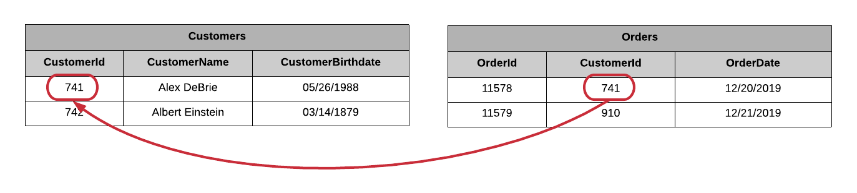
In RDBMS

Slide 56
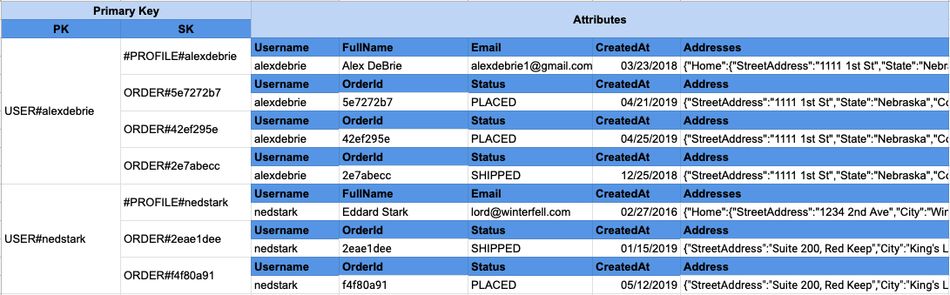
Pre-join data into item collections in dynamodb
Want to fetch the User and Orders, we can do it in a single request without needing a costly join operation

Slide 57
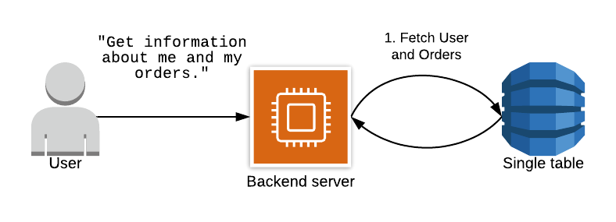
In Dynamodb

Slide 58
Advantages of a single-table design
Retrieve multiple, heterogenous item types using a single request.
Have one table with all items in it rather than eight separate tables, can reduce the number of alarms and metrics to watch.
Can save money as compared to having multiple tables.
With each table, need to provision read and write capacity units.
Often you will do some back-of-the-envelope math on the traffic you expect, bump it up by X%, and convert it to RCUs and WCUs.

Slide 59
Downsides of a single-table design
Steep learning curve to understand single-table design;
Inflexibility of adding new access patterns;
Difficulty of exporting your tables for analytics
DynamoDB is not good at OLAP queries. This is intentional.
DynamoDB focuses on being ultra-performant at OLTP queries and wants you to use other, purpose-built databases for OLAP.

Slide 60
Key aspects of Dynamo

Slide 61
No Relational model
Relational data model is a useful way to model many types of data.
Relational data is normalized to improve the integrity of the data.
Rather than duplicating a particular piece of data in multiple rows, you can store it in one place and refer to it using a JOIN operation from one table to another.
Now you can update that single place, and all items that refer to that data will gain the benefits of the update as well.
The JOIN operation is expensive.
At a large enough scale, engineers often denormalize their data to avoid making expensive joins and slowing down response times.
This decrease in response time comes with a trade-off of increased application complexity -- now you need to manage more of data integrity issues in your code rather than your database.

Slide 62
Dynamodb Features
NoSQL database service that provides fast and predictable performance with seamless scalability.
Offers encryption at rest.
Can create database tables that can store and retrieve any amount of data, and serve any level of request traffic.
Can scale up or scale down your tables’ throughput capacity without downtime or performance degradation, and use the AWS Management Console to monitor resource utilization and performance metrics.
Provides on-demand backup capability as well as enable point-in-time recovery for the DynamoDB tables. With point-in-time recovery, can restore that table to any point in time during the last 35 days.

Slide 63
Dynamodb Features
Data is stored in partitions, backed by solid state disks (SSDs) and automatically replicated across multiple AZs in an AWS region, providing built-in high availability and data durability.
Can create tables that are automatically replicated across two or more AWS Regions, with full support for multi-master writes.
AWS now specifies the IP address ranges for Amazon DynamoDB endpoints.
Can use these IP address ranges in the routing and firewall policies to control outbound application traffic.
Can also use these ranges to control outbound traffic for applications in the Amazon Virtual Private Cloud, behind AWS Virtual Private Network or AWS Direct Connect.

Slide 64
Core Components
Tables – a collection of items
DynamoDB stores data in a table, which is a collection of data.
Are schemaless.
Initial limit of 256 tables per region.
Items – a collection of attributes
DynamoDB uses primary keys to uniquely identify each item in a table and secondary indexes to provide more querying flexibility.
Each table contains zero or more items.

Slide 65
Core Components
Attributes – a fundamental data element
DynamoDB supports nested attributes up to 32 levels deep.
Primary Key – uniquely identifies each item in the table, so that no two items can have the same key. Must be scalar.
Partition key – a simple primary key, composed of one attribute.
Partition key and sort key (composite primary key) – composed of two attributes.
Uses the partition key value as input to an internal hash function.
Output from the hash function determines the partition in which the item will be stored.
All items with the same partition key are stored together, in sorted order by sort key value.
If no sort key is used, no two items can have the same partition key value.

Slide 66
Core Components
Secondary Indexes – Used to query the data in the table using an alternate key, in addition to queries against the primary key.
Can create one or more secondary indexes on a table.
Two kinds of indexes:
Global secondary index – An index with a partition key and sort key that can be different from those on the table.
Local secondary index – An index that has the same partition key as the table, but a different sort key.
Can define up to 20 global secondary indexes and 5 local secondary indexes per table.

Slide 67
Core Components
DynamoDB Streams – an optional feature that captures data modification events in DynamoDB tables.
Naming convention for DynamoDB Streams endpoints is streams.dynamodb..amazonaws.com
Each event is represented by a stream record, and captures the following events:
A new item is added to the table: captures an image of the entire item, including all of its attributes.
An item is updated: captures the “before” and “after” image of any attributes that were modified in the item.
An item is deleted from the table: captures an image of the entire item before it was deleted.
Each stream record also contains the name of the table, the event timestamp, and other metadata.
Stream records are organized into groups, or shards.

Slide 68
Core Components
DynamoDB Streams –Stream records are organized into groups, or shards.
Each shard acts as a container for multiple stream records, and contains information required for accessing and iterating through these records.
Stream records have a lifetime of 24 hours; after that, they are automatically removed from the stream.
Can use DynamoDB Streams together with AWS Lambda to create a trigger, which is a code that executes automatically whenever an event of interest appears in a stream.
DynamoDB Streams enables powerful solutions such as data replication within and across Regions, materialized views of data in DynamoDB tables, data analysis using Kinesis materialized views, and much more.

Slide 69
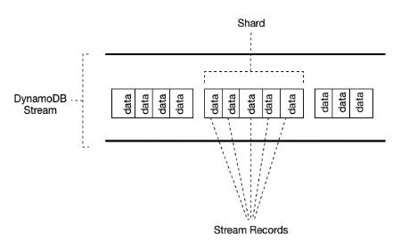

Slide 70
Throttling requests
To create a table or index in DynamoDB, must specify your throughput capacity requirements for read and write activity in terms of:
One read capacity unit represents one strongly consistent read per second, or two eventually consistent reads per second, for an item up to 4 KB in size.
To read an item that is larger than 4 KB, DynamoDB will need to consume additional read capacity units.
One write capacity unit represents one write per second for an item up to 1 KB in size.
To write an item that is larger than 1 KB, DynamoDB will need to consume additional write capacity units.
Throttling prevents the application from consuming too many capacity units.
DynamoDB can throttle read or write requests that exceed the throughput settings for a table, and can also throttle read requests exceeds for an index.
When a request is throttled, it fails with an HTTP 400 code (Bad Request) and a ProvisionedThroughputExceededException.

Slide 71
Throughput Management
Provisioned throughput – manually defined maximum amount of capacity that an application can consume from a table or index.
If the application exceeds the provisioned throughput settings, it is subject to request throttling.
Free tier eligible.

Slide 72
DynamoDB Auto Scaling
When you use the AWS Management Console to create a new table, DynamoDB auto scaling is enabled for that table by default.
Uses the AWS Application Auto Scaling service to dynamically adjust provisioned throughput capacity on your behalf, in response to actual traffic patterns.
Can create a scaling policy for a table or a global secondary index.
Scaling policy specifies whether you want to scale read capacity or write capacity (or both), and the minimum and maximum provisioned capacity unit settings for the table or index.
Also contains a target utilization, which is the percentage of consumed provisioned throughput at a point in time.

Slide 73
DynamoDB auto scaling
Define a range (upper and lower limits) for read and write capacity units, and define a target utilization percentage within that range.
A table or a global secondary index can increase its provisioned read and write capacity to handle sudden increases in traffic, without request throttling.
DynamoDB auto scaling can decrease the throughput when the workload decreases so that you don’t pay for unused provisioned capacity.
Reserved capacity – with reserved capacity, you pay a one-time upfront fee and commit to a minimum usage level over a period of time, for cost-saving solutions.
DynamoDB auto scaling doesn’t prevent from manually modifying provisioned throughput settings.
If you enable DynamoDB auto scaling for a table that has one or more global secondary indexes, AWS highly recommends that you also apply auto scaling uniformly to those indexes.

Slide 74
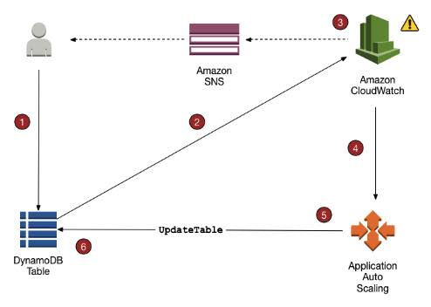

Slide 75
Core Components
On-Demand Backup and Restore -- Can use IAM to restrict DynamoDB backup and restore actions for some resources.
All backup and restore actions are captured and recorded in AWS CloudTrail.
Backups
Each time you create an on-demand backup, the entire table data is backed up.
All backups and restores in DynamoDB work without consuming any provisioned throughput on the table.
DynamoDB backups do not guarantee causal consistency across items; however, the skew between updates in a backup is usually much less than a second.
Can restore backups as new DynamoDB tables in other regions.

Slide 76
On-Demand Backup and Restore
Included in the backup are:
Database data
Global secondary indexes
Local secondary indexes
Streams
Provisioned read and write capacity
While a backup is in progress, can’t do the following:
Pause or cancel the backup operation.
Delete the source table of the backup.
Disable backups on a table if a backup for that table is in progress.

Slide 77
Core Components
On-Demand Backup and Restore
Restore
Cannot overwrite an existing table during a restore operation.
Can restore backups to a new table.
For tables with even data distribution across your primary keys, the restore time is proportional to the largest single partition by item count and not the overall table size.
If your source table contains data with significant skew, the time to restore may increase.

Slide 78
Core Components
DynamoDB Transactions
Making coordinated, all-or-nothing changes to multiple items both within and across tables.
Transactions provide atomicity, consistency, isolation, and durability (ACID) in DynamoDB, helping you to maintain data correctness in your applications.
Can group multiple Put, Update, Delete, and ConditionCheck actions.
Can then submit the actions as a single TransactWriteItems operation that either succeeds or fails as a unit.
Can group and submit multiple Get actions as a single TransactGetItems operation.
Amazon DynamoDB supports up to 25 unique items and 4 MB of data per transactional request.

Slide 79
Core Components
Global Tables
Deploying a multi-region, multi-master database, without having to build and maintain own replication solution.
Specify the AWS regions where you want the table to be available.
DynamoDB performs all tasks to create identical tables in these regions, and propagate ongoing data changes to all of them.
Replica Table (Replica, for short)
A single DynamoDB table that functions as a part of a global table.
Each replica stores the same set of data items.
Any given global table can only have one replica table per region.
Can add new or delete replicas from global tables.

Slide 80
Global Tables
To ensure eventual consistency, DynamoDB global tables use a “last writer wins” reconciliation between concurrent updates, where DynamoDB makes a best effort to determine the last writer.
If a single AWS region becomes isolated or degraded, application can redirect to a different region and perform reads and writes against a different replica table.
DynamoDB also keeps track of any writes that have been performed, but have not yet been propagated to all of the replica tables.

Slide 81
Global Tables
Requirements for adding a new replica table
Table must have the same partition key as all of the other replicas.
Table must have the same write capacity management settings specified.
Table must have the same name as all of the other replicas.
Table must have DynamoDB Streams enabled, with the stream containing both the new and the old images of the item.
None of the replica tables in the global table can contain any data.
If global secondary indexes are specified, then the following conditions must also be met:
The global secondary indexes must have the same name.
The global secondary indexes must have the same partition key and sort key (if present).

Slide 82
Core Components
Security --Encryption
Encrypts data at rest using an AWS Key Management Service (AWS KMS) managed encryption key for DynamoDB.
Encryption at rest can be enabled only when you are creating a new DynamoDB table.
After encryption at rest is enabled, it can’t be disabled.
Uses AES-256 encryption.
The following are encrypted:
DynamoDB base tables
Local secondary indexes
Global secondary indexes

Slide 83
Core Components
Security -- Authentication and Access Control
Access to DynamoDB requires credentials.
Aside from valid credentials, also need to have permissions to create or access DynamoDB resources.
Types of Identities
AWS account root user
IAM user
IAM role

Slide 84
Core Components
Can create indexes and streams only in the context of an existing DynamoDB table, referred to as subresources.
Resources and subresources have unique Amazon Resource Names (ARNs) associated with them.
A permissions policy describes who has access to what.
Identity-based Policies
Attach a permissions policy to a user or a group in your account
Attach a permissions policy to a role (grant cross-account permissions)
Policy Elements
Resource – use an ARN to identify the resource that the policy applies to.
Action – use action keywords to identify resource operations that you want to allow or deny.
Effect – specify the effect, either allow or deny, when the user requests the specific action.
Principal – the user that the policy is attached to is the implicit principal.
Web Identity Federation – Customers can sign in to an identity provider and then obtain temporary security credentials from AWS Security Token Service (AWS STS).

Slide 85
Core Components
Monitoring
Automated tools:
Amazon CloudWatch Alarms – Watch a single metric over a time period that you specify, and perform one or more actions based on the value of the metric relative to a given threshold over a number of time periods.
Amazon CloudWatch Logs – Monitor, store, and access your log files from AWS CloudTrail or other sources.
Amazon CloudWatch Events – Match events and route them to one or more target functions or streams to make changes, capture state information, and take corrective action.
AWS CloudTrail Log Monitoring – Share log files between accounts, monitor CloudTrail log files in real time by sending them to CloudWatch Logs, write log processing applications in Java, and validate that your log files have not changed after delivery by CloudTrail.

Slide 86
DynamoDB Accelerator (DAX)
Fully managed, highly available, in-memory cache for DynamoDB.
Delivers microsecond response times for accessing eventually consistent data.
Requires only minimal functional changes to use DAX with an existing application since it is API-compatible with DynamoDB.
For read-heavy or bursty workloads, DAX provides increased throughput and potential cost savings by reducing the need to overprovision read capacity units.
Allows scale on-demand.
DAX is fully managed. --No longer need to do hardware or software provisioning, setup and configuration, software patching, operating a reliable, distributed cache cluster, or replicating data over multiple instances as you scale.
Not recommended for strongly consistent reads.
Useful for read-intensive workloads, but not write-intensive ones.
Supports server-side encryption as well as encryption in transit.

Slide 87
Use Cases of DAX
Applications that require the fastest possible response time for reads.
Applications that read a small number of items more frequently than others. For example, limited-time on-sale items in an ecommerce store.
Applications that are read-intensive, but are also cost-sensitive.
Offload read activity to a DAX cluster and reduce the number of read capacity units that you need to purchase for your DynamoDB tables.
Applications that require repeated reads against a large set of data.
Will avoid eating up all your DynamoDB resources which are needed by other applications.

Slide 88
DAX cluster
To achieve high availability for the application, provision the DAX cluster with at least three nodes, then place the nodes in multiple Availability Zones within a Region.
Scaling a DAX cluster:
Horizontal scaling, where you add read replicas to the cluster.
A single DAX cluster supports up to 10 read replicas, and you can add or remove replicas while the cluster is running.
Vertical scaling, --Select different node types.
Larger nodes enable the cluster to store more data in memory, reducing cache misses and improving overall application performance.
Can’t modify the node types on a running DAX cluster.
Instead, must create a new cluster with the desired node type.

Slide 89
Distributed Architecture
Amazon DynamoDB is available in multiple AWS Regions around the world.
Every AWS Region consists of multiple distinct locations called Availability Zones.
Each Availability Zone is isolated from failures in other Availability Zones, and provides inexpensive, low-latency network connectivity to other Availability Zones in the same Region.
Allows rapid replication of your data among multiple Availability Zones in a Region.
When your application writes data to a DynamoDB table and receives an HTTP 200 response (OK), the write has occurred and is durable.
Data is eventually consistent across all storage locations, usually within one second or less.
DynamoDB supports 2 read types:
Eventually Consistent Reads – When you read data from a DynamoDB table, the response might not reflect the results of a recently completed write operation. The response might include some stale data. If you repeat your read request after a short time, the response should return the latest data.
Strongly Consistent Reads – When you request a strongly consistent read, DynamoDB returns a response with the most up-to-date data, reflecting the updates from all prior write operations that were successful.

Slide 90
Pricing
DynamoDB charges per GB of disk space that your table consumes. The first 25 GB consumed per month is free.
DynamoDB charges for Provisioned Throughput —- WCU and RCU, Reserved Capacity and Data Transfer Out.
You should round up to the nearest KB when estimating how many capacity units to provision.
There are additional charges for DAX, Global Tables, On-demand Backups (per GB), Continuous backups and point-in-time recovery (per GB), Table Restorations (per GB), and Streams (read request units).

Slide 91
Validate Your Knowledge

Slide 92
Question 1
A company is developing a mobile game that uses an Amazon DynamoDB table with the default configuration. When the player’s score changes, the game must update the score and show the latest data on the real-time leaderboard using the GetItem API. It should fetch the most up-to-date data from all successful write operations and not return any stale data.
What additional action should the Database Specialist do to implement this feature properly?
Set the ConsistentRead parameter to true when using the GetItem operation.
No additional action needed since the GetItem API already provides a strongly consistent read by default.
Enable the DynamoDB Streams feature to automatically run the GetItem operations with strong consistent read.
Use DynamoDB Accelerator (DAX) to ensure that the GetItem API fetches the most up-to-date data from all successful write operations.

Slide 93
Explanation for Question1
The GetItem operation returns a set of attributes for the item with the given primary key.
If there is no matching item, GetItem does not return any data and there will be no Item element in the response.
GetItem provides an eventually consistent read by default.
If the application requires a strongly consistent read, set ConsistentRead to true.
Although a strongly consistent read might take more time than an eventually consistent read, it always returns the last updated value.
Hence, the correct answer is: Set the ConsistentRead parameter to true when using the GetItem operation.

Slide 94
Explanation for Question1
The option that says: No additional action needed since the GetItem API already provides a strongly consistent read by default is incorrect because, by default, the GetItem operation only provides an eventually consistent read. Have to manually set the ConsistentRead parameter to true to instruct the GetItem operation to use a strongly consistent read.
The option that says: Enable the DynamoDB Streams feature to automatically run the GetItem operations with strong consistent read is incorrect because the DynamoDB Streams feature simply captures a time-ordered sequence of item-level modifications in your DynamoDB table and stores this information in a log for up to 24 hours. Can’t be used to make the GetItem operation to use strongly consistent reads.
The option that says: Use DynamoDB Accelerator (DAX) to ensure that the GetItem API fetches the most up-to-date data from all successful write operations is incorrect because DynamoDB Accelerator is just an in-memory cache that provides microsecond latency and delivers up to a 10x read performance improvement to your applications. DAX is not ideal for applications that require strongly consistent reads and systems that cannot tolerate stale data due to eventually consistent reads.

Slide 95
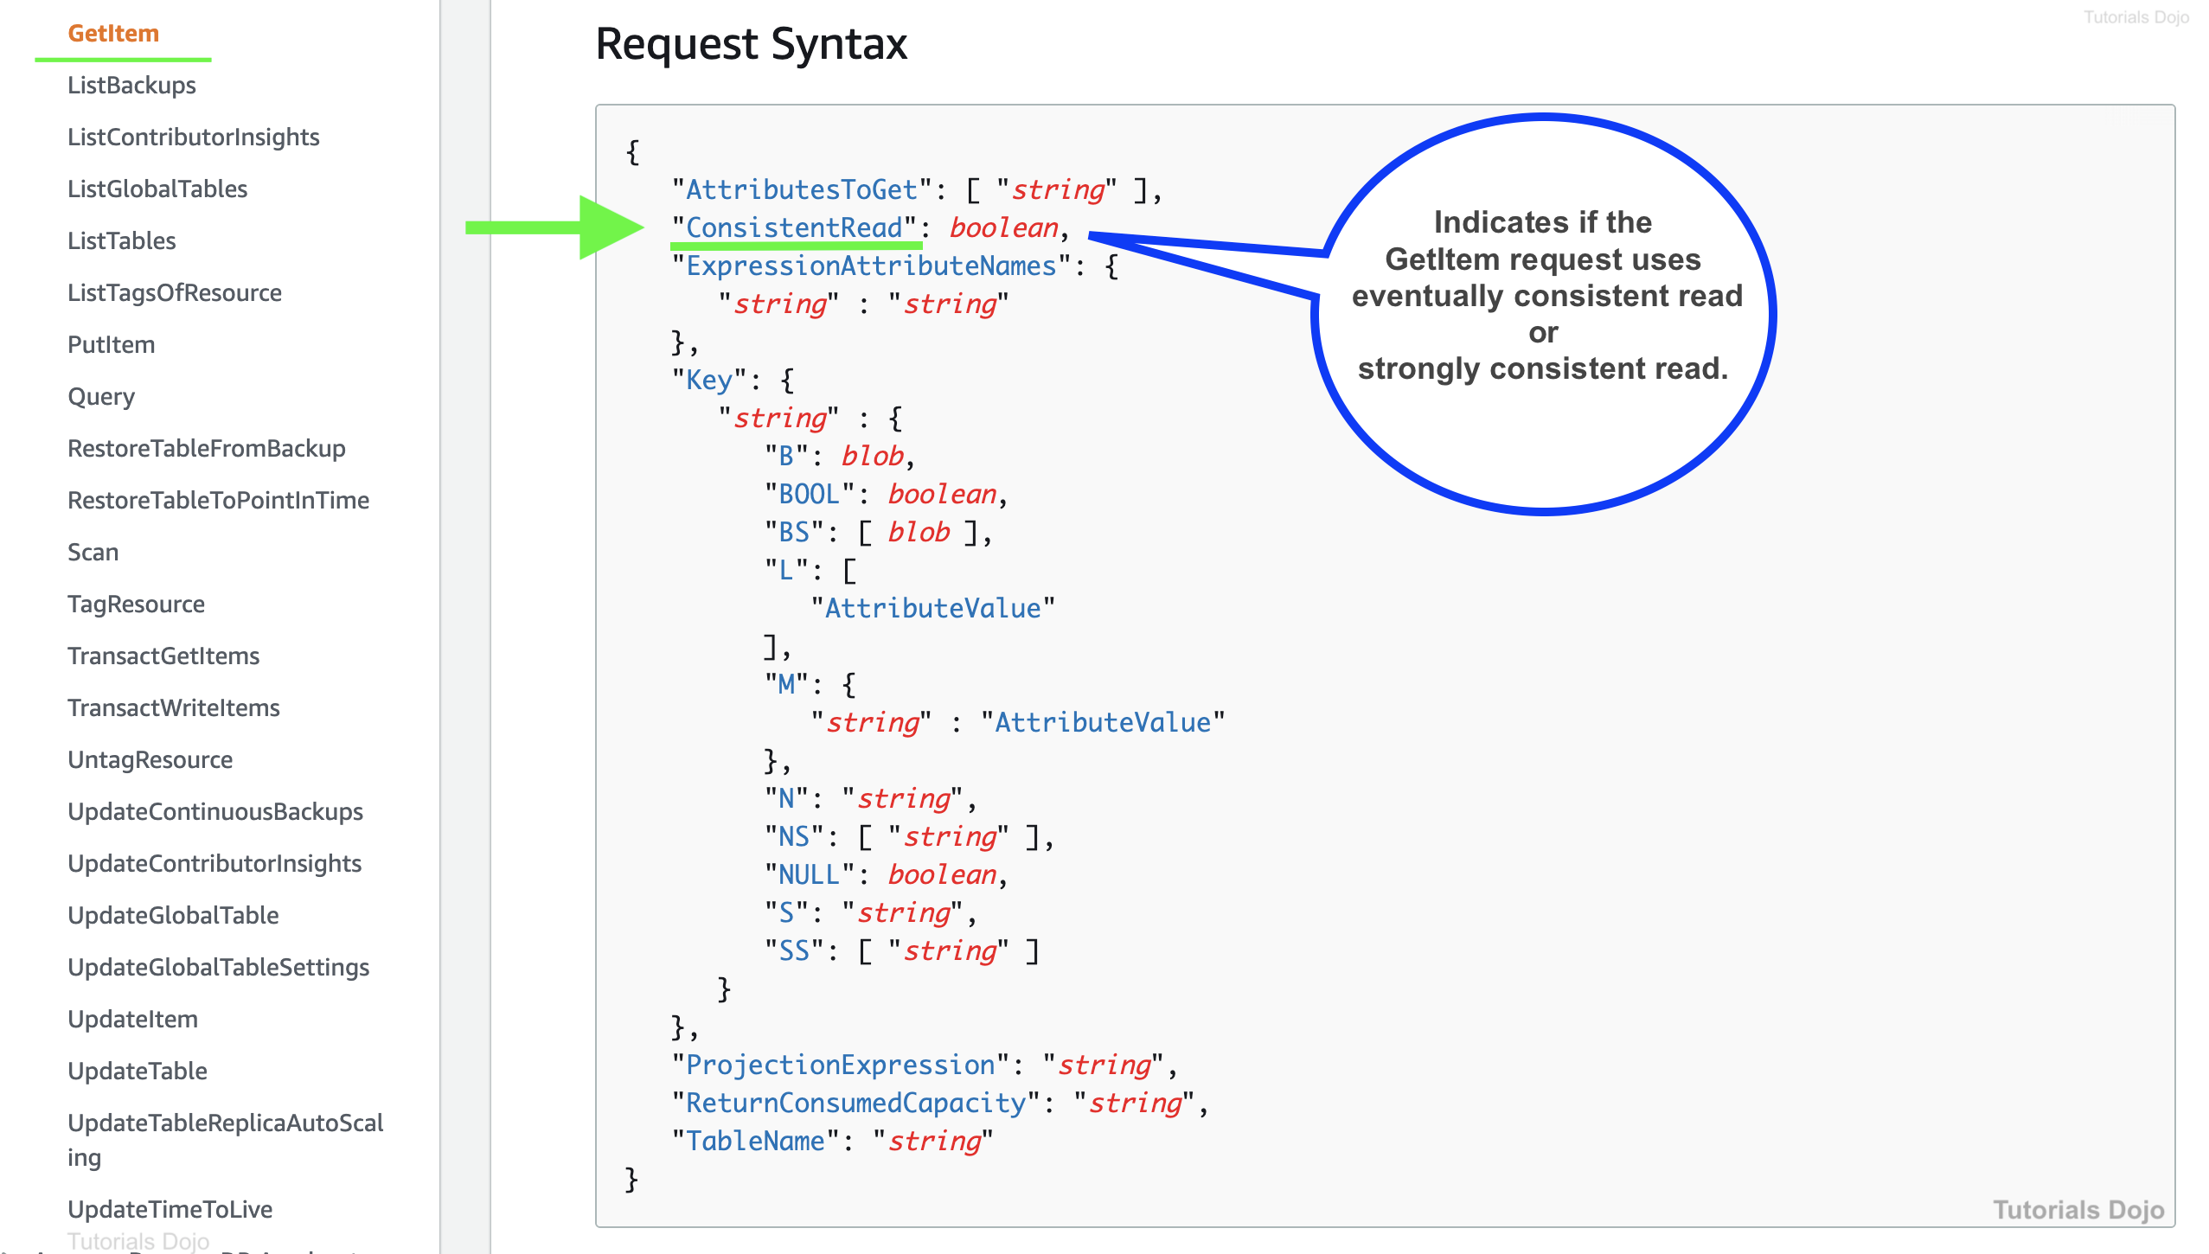

Slide 96
Question 2
You have two users concurrently accessing a DynamoDB table and submitting updates. If a user will modify a specific item in the table, she needs to make sure that the operation will not affect another user’s attempt to modify the same item. You have to ensure that your update operations will only succeed if the item attributes meet one or more expected conditions.
Which of the following DynamoDB features should you use in this scenario?
Projection Expressions
Update Expressions
Conditional writes
Batch Operations

Slide 97
Answer for Question 2:
Correct Answer: 3
By default, the DynamoDB write operations (PutItem, UpdateItem, DeleteItem) are unconditional: each of these operations will overwrite an existing item that has the specified primary key.
DynamoDB optionally supports conditional writes for these operations.
A conditional write will succeed only if the item attributes meet one or more expected conditions.
Otherwise, it returns an error. Conditional writes are helpful in cases where multiple users attempt to modify the same item.
For example, by adding a conditional expression that checks if the current value of the item is still the same, you can be sure that your update will not affect the operations of other users:

Slide 98
Answer for Question 2:
aws dynamodb update-item \
--table-name ProductCatalog \
--key '{"Id":{"N":"1"}}' \
--update-expression "SET Price = :newval" \
--condition-expression "Price = :currval" \
--expression-attribute-values file://expression-attribute-values.json

Slide 99
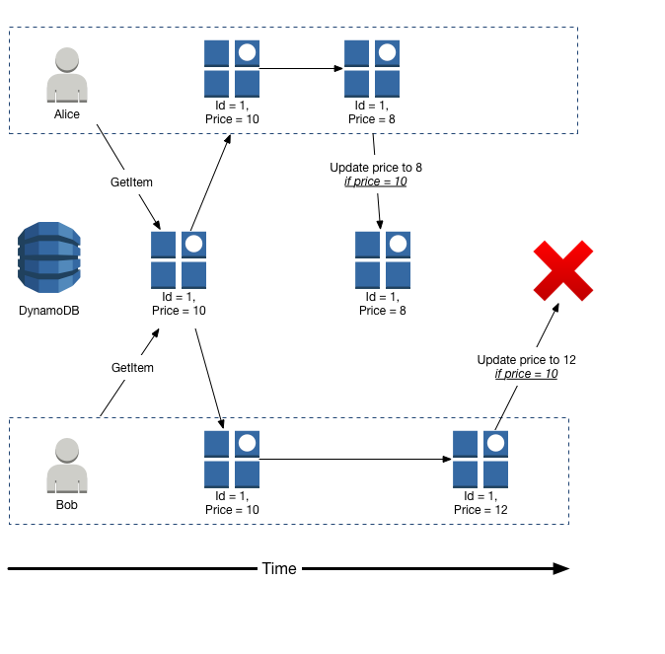

Slide 100
Answer for Question 2:
Using projection expressions is incorrect because this is just a string that identifies the attributes you want to retrieve during a GetItem, Query, or Scan operation. Take note that the scenario calls for a feature that can be used during a write operation hence, this option is irrelevant.
Using update expressions is incorrect because this simply specifies how UpdateItem will modify the attributes of an item such as for setting a scalar value or removing elements from a list or a map. This feature doesn’t use any conditions which is what the scenario is looking for. Therefore, this option is incorrect.
Using batch operations is incorrect because these are essentially wrappers for multiple read or write requests. Batch operations are primarily used when you want to retrieve or submit multiple items in DynamoDB through a single API call, which reduces the number of network round trips from your application to DynamoDB.

